Slide 1
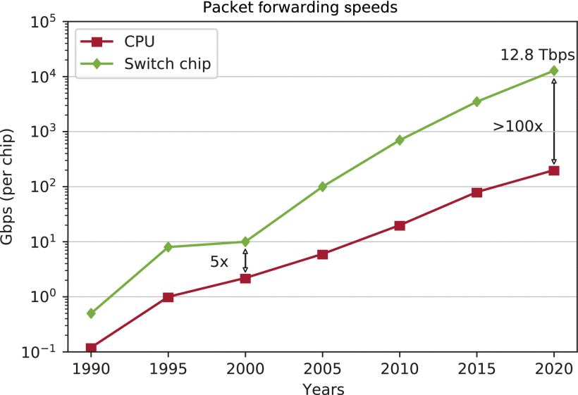
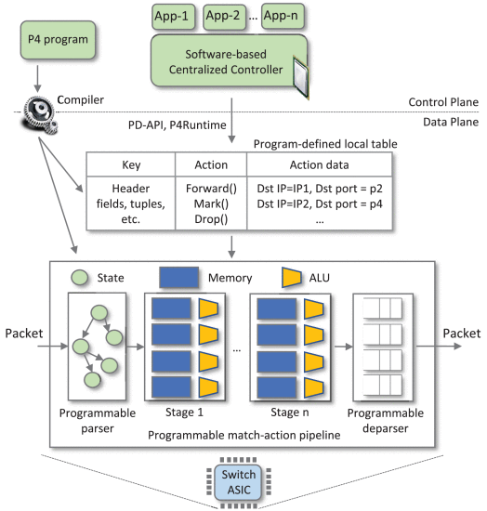
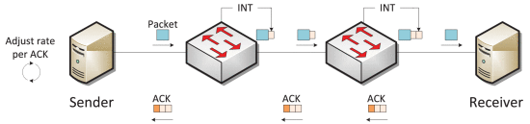
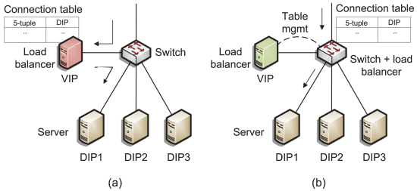


P4 Programmable Data-Plane Switches
Joseph Telaak, Elie Kfoury, Jose Gomez, Ali AlSabeh, Shahrin Sharif, Jorge Crichigno, PhD.
College of Engineering and Computing, Integrated Information Technology Department,
University of South Carolina, SC
Background
Technology
Most network switches available to the consumer are unmanaged: a user plugs in the ethernet cable and it just works. All that these switches do is check the destination address and forward the packet out of the appropriate port. Vendors like Cisco and Juniper offer another type of switch, the managed switch. These types of switches work off the same basic idea as an unmanaged switch, but with added configurability and features. These switches can be configured in a variety of ways, such as disabling unused ports to lock down the security of the switch or tying ports to VLANs to run different networks on the same physical hardware. The data planes in these switches are hard-coded by vendors. The data-plane refers to the part of the switch software that is concerned with forwarding packets. There is also a control plane, which defines how to process those packets. In traditional switches, the control plane can be modified by enabling/disabling applications. In 2014, P4 (Programming Protocol-independent Packet Processors) was developed in order to allow programmers and researchers do define custom control and data planes on specialized hardware. P4 is the programming language used to write the functionality.
The P4 language is target-independent, meaning that it can be compiled for many different machines, such as ASICs, and CPUs. P4 is protocol-independent and does not have native support for Ethernet or IP, so everything is defined by the programmer. Though P4 supports CPUs, packet switching on purpose-built ASICs provides a significant speed benefit (over 100x).
Applications
The applications of this type of switch are limited by whatever researchers and programmers can develop. One of the more basic examples is implementing In-Band Network Telemetry (INT) to keep real-time data of network health. The switches can add metadata to each packet that will later be removed and stored. This data can also be used to mitigate network congestion and keep usage fair.
These switches can also be used for load balancing. Typical load balancers work by acting as the webserver, but instead, distributes load amongst real servers. With P4 switches, a server can manage the server pool while the switch forwards the requests. This method increases throughput while decreasing latency.
Purpose
The rollout of new features depends on the vendors, who must go through a lengthy and expensive design process to include new features. In some cases, protocols can take years to be implemented. With data-plane programmability, researchers can develop new protocols and applications cheaper and much faster, allowing for more experimentation. This programmability opens these devices up to many use cases that would benefit from running an application directly on the switch.
E. F. Kfoury, J. Crichigno and E. Bou-Harb, "An Exhaustive Survey on P4 Programmable Data Plane Switches: Taxonomy, Applications, Challenges, and Future Trends," in IEEE Access, vol. 9, pp. 87094-87155, 2021, doi: 10.1109/ACCESS.2021.3086704.

